Slide 1

AOLME Curriculum SESSION 2
MATERIALS DEVELOPED BY THE AOLME PROJECT AT THE UNIVERSITY OF NEW MEXICO, PLEASE DO NOT COPY OR DISTRIBUTE ANY OF THESE COPYRIGHTED TASKS WITHOUT PROPER AUTHORIZATION OF PROJECT

Slide 2


Level 1
SESSION 1: Basic of Raspberry PI and Linux-(motivational overview of projects-images, ls, cd) SESSION 2: Introduction to Python Programming (print, algebra, strings) SESSION 3: Algorithms (for and while loops, range commands, if statements, inequalities, sprite movement) SESSION 4: The Coordinate Plane and Black & White Images in Python SESSION 5: Binary and Hexadecimal number systems SESSION 6: Images and Their Components (histograms) SESSION 7: Creation of Images and Video FINAL PROJECT: VIDEO

Slide 3
introduction to Python Programming
OBJECTIVES:
Apply basics of Python Programming.
Program basic operations and variables in Python.
Solve and create own operations, and arithmetic-algebraic expressions.
Program a number guessing game using Python.

Slide 4

Selected ACTIVITIES
1. Exploring Python Programming (print, strings, basic operations)
2. Programming Operations with Python (linear equations, order of operations, and complex expressions)
3. Creating Your Guessing Game w/ Python (design, program, and share game by altering initial, base codes)

Slide 5
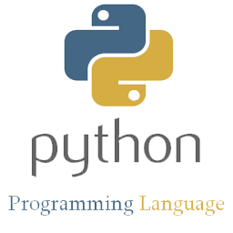


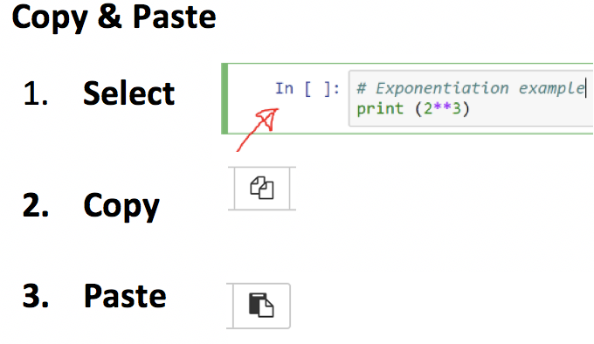
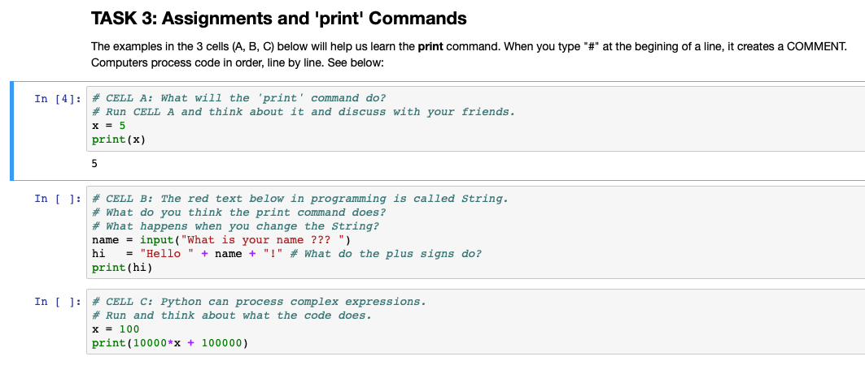

2.1. Exploring Programming with Python
Note: The numbers in the Card match the Tasks numbers in the Jupyter Notebook.
1. Practice Python programming using Jupyter. Open the terminal: . Go to AOLME directory & type in: jupyter notebook. Hit Enter & in Jupyter open ‘Session 2’ folder. Click New and then click Python 3.
2. To play the Guessing Game: (a) open Session 2 file in Jupyter,
(b) In Task 2, select the cell named: EXAMPLE with game code,
(c) click ‘run’
(d) at bottom, enter data it asks for
(e) take turns
(f) clear cell by clicking on ‘run’ again and enter new data.
In file you created, navigate Jupyter by exploring what each icon on the the taskbar does.
What’s a cell?
SAVE your work every time by clicking on this icon.
A cell looks like a space to enter information. You can copy and erase cells..
Think and talk: How do you think this works?
3. Run & play CELLS A-C in Task 3. What do you notice about the print command?
4. Discuss & Create: Based on what you did and learned in task 3, in TASK 4 write your own code. Take turns typing.
Be creative and have fun!
Why does the cell color change?
What do you notice about the red words and what appears below the cells? What if you changed the red words?
These boxes are (Python or Text) cells. Some have: ‘In [ ]’ and others don’t. Why?
Have you played the guessing game before?
AOLME PROJECT - LEVEL 1- SESSION 2- 2019
MATERIALS DEVELOPED BY THE AOLME PROJECT AT THE UNIVERSITY OF NEW MEXICO, PLEASE DO NOT COPY OR DISTRIBUTE ANY OF THESE COPYRIGHTED TASKS WITHOUT PROPER AUTHORIZATION

Slide 6

2.1. Exploring Programming with Python
Note: The numbers in Card match the Tasks numbers in Jupyter Notebook.
Resources for the Activity
Recommended Steps for the Activity
Activity Card
Folder: /home/pi/AOLME/Session 2/
the “Jupyter” notebook accessed via Terminal
Raspberry Pi and Monitor
Student journal
Make sure that for the first task students open the ‘Untitled’ file in Session 2 folder. Have them type and try all icons in taskbar. Have them explore and then talk about what the discover. They might make connections to what they’ve done in other computers.
Have students realize different types of cells.
When playing guessing game, let students take turns playing game, maybe by pairs? Taking turns typing?
Task 3 it’s important to notice ‘print’ and what if they didn’t typed print? What happens? Let them experiment especially notice that the red text or strings can be changed to any language even, but green words can’t be changed.
Have students debrief what they learned by experimenting and have them write notes in journal.
Everyone in the team gets to play a role:
Discussion Expert: Leads the team discussion asking questions about what the session is about.
Fair Participation Expert: makes sure of fair participation of everyone.
Hardware Setup/Teardown Expert: in charge of setting up & putting away materials and computer equipment.
Summary Expert: summarizes and records team questions and what the teams has learned.
Activity 1 Goal: Apply basics of Python Programming.
AOLME PROJECT - LEVEL 1- SESSION 2- 2019
MATERIALS DEVELOPED BY THE AOLME PROJECT AT THE UNIVERSITY OF NEW MEXICO, PLEASE DO NOT COPY OR DISTRIBUTE ANY OF THESE COPYRIGHTED TASKS WITHOUT PROPER AUTHORIZATION

Slide 7
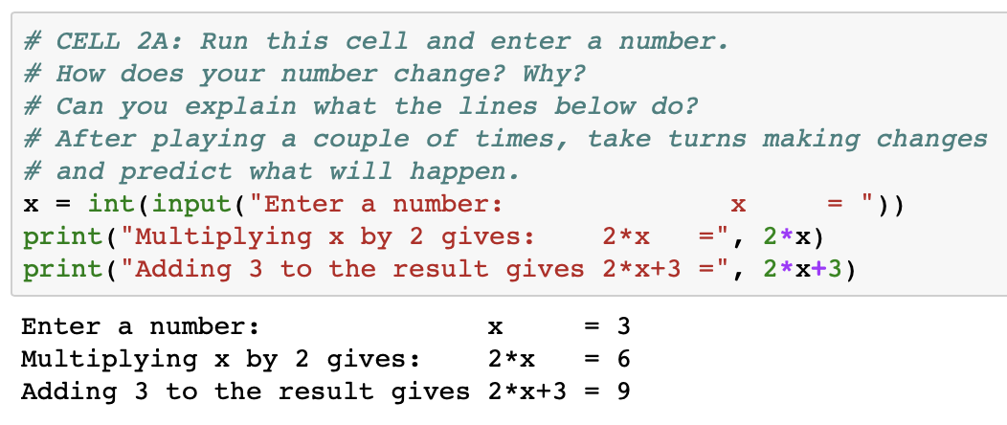
2.2. Programming Number Operations w/ Python
Note: The numbers in the Card match the Tasks numbers in the Jupyter Notebook.
1. Let’s use Algebra and Mathematics to program the Guessing Game with Python.
2. In CELL 2A in jupyter, run the code multiple times & discuss what happens . Then make & predict changes.
The number entered for ‘x’ is 3. How are the 6 and 9 related to 3?
In the Guessing Game, we don’t know the number the person is thinking. All we know is the operations we ask them to do. Next, focus on how the operations relate to the number to be guessed.
enter other numbers, explore how they relate.
3. In CELL 2B in jupyter, there are variables (x, y and z). What is a variable? Run this Cell multiple times and change the numbers, operations and re-name the variables.
4. In CELL 2C, create your own game by modifying the operations and replacing the ‘?’ with numbers. Re-name variables, if wanted.
Talk: How do you think Python helps us do math? How are programming and thinking alike?
How do you think we can use variables and operations to guess a number we don’t know?
AOLME PROJECT - LEVEL 1- SESSION 2- 2019
MATERIALS DEVELOPED BY THE AOLME PROJECT AT THE UNIVERSITY OF NEW MEXICO, PLEASE DO NOT COPY OR DISTRIBUTE ANY OF THESE COPYRIGHTED TASKS WITHOUT PROPER AUTHORIZATION

Slide 8
2.2. Programming Number Operations w/ Python
Note: The numbers in Card match the Tasks numbers in Jupyter Notebook.
Resources for the Activity
Recommended steps for the Activity
Make sure that students understand that variables can be determined in many ways. Have them identify and talk about them every time they define them.
When running each cell, make sure to have them predict and then try to identify what each code lines does. Perhaps changing numbers can help figure out better what the codes do.
Discuss how the order of operations, grouping and definitions of variables might help solve a problem.
Activity Card
the “Jupyter” notebook accessed via Terminal
Folder: /home/pi/AOLME/Session 2/
Raspberry Pi and Monitor
Student journal
Activity 2 Goal 1: Program basic operations and variables in Python. Goal 2: Solve and create own operations, and arithmetic-algebraic expressions.
AOLME PROJECT - LEVEL 1- SESSION 2- 2019
MATERIALS DEVELOPED BY THE AOLME PROJECT AT THE UNIVERSITY OF NEW MEXICO, PLEASE DO NOT COPY OR DISTRIBUTE ANY OF THESE COPYRIGHTED TASKS WITHOUT PROPER AUTHORIZATION

Slide 9



2.3. Creating Your Number Guessing Game w/ Python
Note: The numbers in the Card match the Tasks numbers in the Jupyter Notebook.
What makes this game work?
2. Inverse Operations: Multiplication is inverse to division
Consider the following for a game:
Give me a number x
Multiply by 2. 2*x
Divide by 2. (2*x)/2=x
After these steps, we are back to x. We "divide by 2" because it is the inverse of "multiply by 2". So it helps get rid of what we multiply by 2. Why do we want to get rid of values we enter?
What’s the inverse operation of addition? Why?
The Number Guessing Game. To make the game work, we need to think about inverse operations.
Why do we need inverse operations for the number guessing game to work?
3. Think: What would this game do?
Give me a number. x
Add 3. x+3
Subtract 3. (x+3)-3=x
4. Design & program in your team a number guessing game. Take turns typing in the codes. Save your work. Use the code in cell 2.3. to start your game. Then, ask someone from another team to play your game.
Use paper to check and predict whether your game will work.
Discuss & write in your journal:
-What did you learn about programming variables and equations?
-How do variables and operations make the game work?
What would be some values or numbers to combine in the guessing game?
AOLME PROJECT - LEVEL 1- SESSION 2- 2019
MATERIALS DEVELOPED BY THE AOLME PROJECT AT THE UNIVERSITY OF NEW MEXICO, PLEASE DO NOT COPY OR DISTRIBUTE ANY OF THESE COPYRIGHTED TASKS WITHOUT PROPER AUTHORIZATION

Slide 10
2.3. Creating Your # Guessing Game w/ Python
Note: The numbers in Card match the Tasks numbers in Jupyter Notebook.
Resources for the Activity
Recommended steps for the Activity
Have students reflect on how numbers cancel each other through inverse operations.
Have them practice on paper getting rid of numbers to ’guess’ the number.
Let students collaborate and have fun and encourage creativity and communication
Try not to tell them, instead ask questions to prompt their thinking.
Invite members from other teams to play the game of your team.
Activity Card
Folder: /home/pi/AOLME/Session2
the “Jupyter” notebook accessed via Terminal
Raspberry Pi kit
Student journal
Evaluate how did the team roles work?
Discussion Expert: Leads the team discussion asking questions about what the session is about.
Fair Participation Expert: makes sure of fair participation of everyone.
Hardware Setup/Teardown Expert: in charge of setting up & putting away materials and computer equipment.
Summary Expert: summarizes and records team questions and what the teams has learned.
Activity 3 Goal: Program a number guessing game using Python.
AOLME PROJECT - LEVEL 1- SESSION 2- 2019
MATERIALS DEVELOPED BY THE AOLME PROJECT AT THE UNIVERSITY OF NEW MEXICO, PLEASE DO NOT COPY OR DISTRIBUTE ANY OF THESE COPYRIGHTED TASKS WITHOUT PROPER AUTHORIZATION

